Slide 1
MCTV Limited
Group Project by:
Remigija Vindasiute(x17432284)
Ioana Avram(x17448556)

Slide 2
Introduction
MCTV limited is a small retail company located in Limerick.
Main products of this company are TV’s.
Company was created by Michael Cooney and his wife Doreen.
The staff consists of 5 people currently.
4 out of 5 staff members are family members.

Slide 3
Division of the Tasks

Slide 4
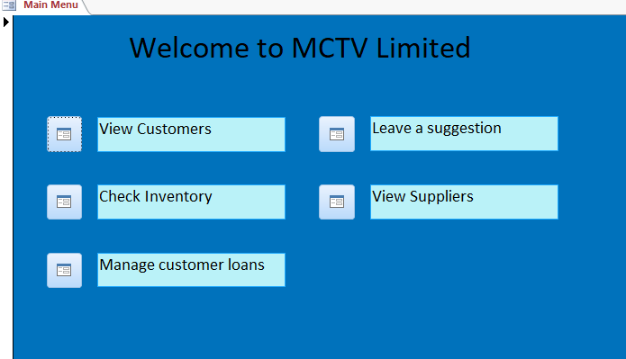
Overview of Database/UML
Main Menu of the Database:

Slide 5
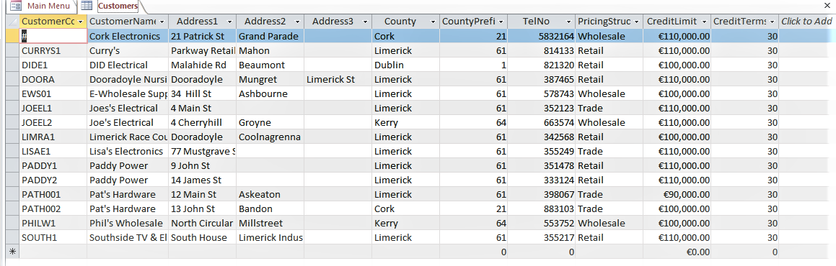
Overview of Database/UML
A sample table in the Database:

Slide 6
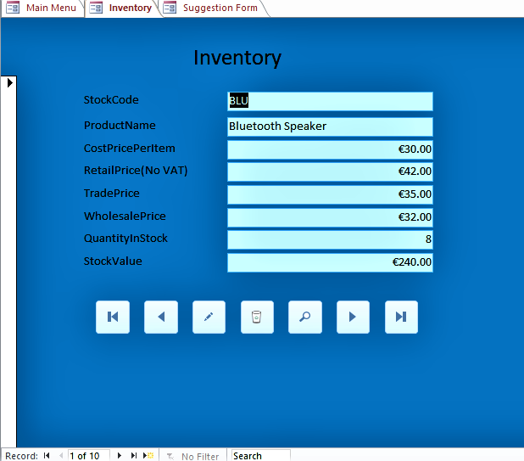
Overview of Database/UML
A sample Form in the database:

Slide 7
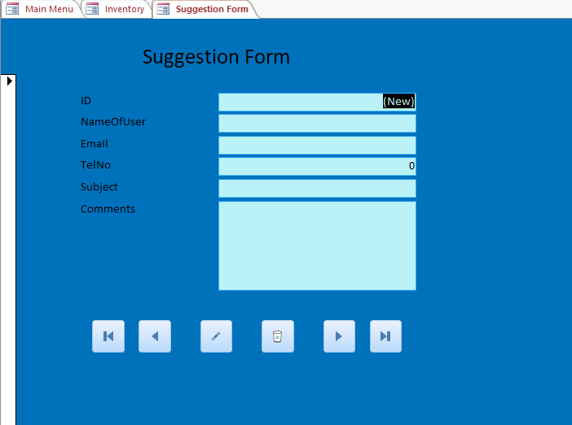
Overview of Database/UML
Suggestion Form:

Slide 8
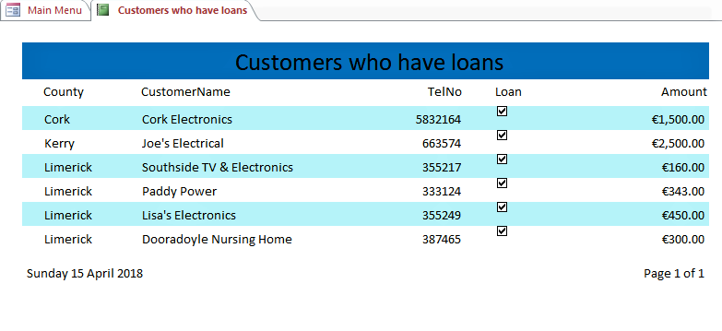
Overview of Database/UML
A sample Report in the Database:

Slide 9
Overview of Database/UML
UML diagram:

Slide 10
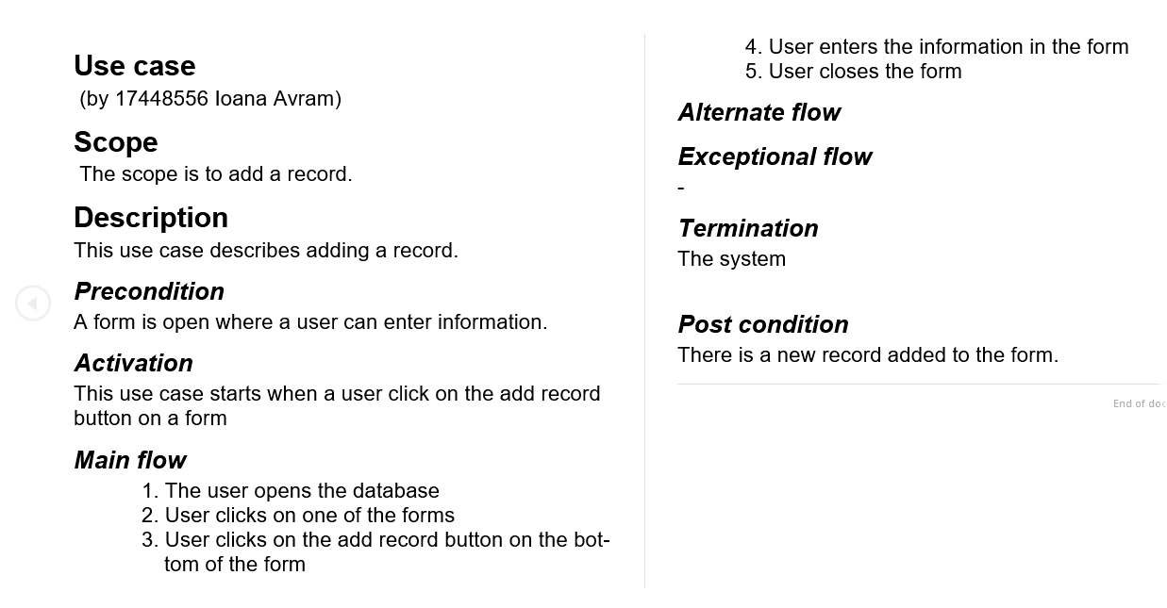
Overview of Database/UML
UML description by Ioana:

Slide 11
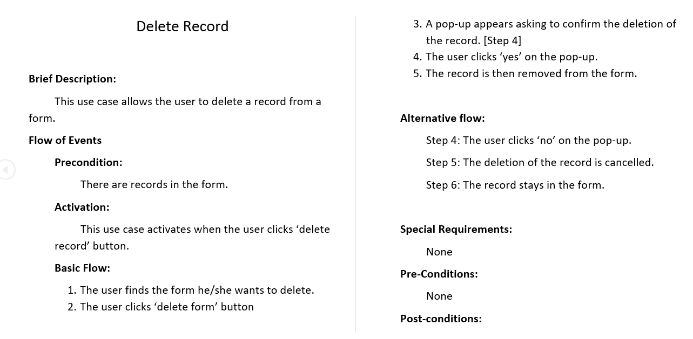
Overview of Database/UML
UML description by Remigija:

Slide 12
Software investigated

Slide 13
Branding

Slide 14
Conclusion

